Slide 1


Slide 2
Team Members
Aviral Srivastava
Roll No. 2000290140035
Section A
Vishal Bharadwaj
Roll No. 2000290140133
Section A
Yash Mittal
Roll No. 20002901400
Section A
Nikhil Upadhyay
Roll No. 2000290140076
Section A

Slide 3
OverView
The Term “Online Shopping”
Online shopping process
Why online Shopping?
Advantages
Disadvantages
Popular Online Shopping Website Are – Amazon , Flipkart , Myntra, etc

Slide 4
Hardware/Software Requirements
Hardware Requirements
Processor : Pentium or higher
RAM : 128MB or Higher
Hard Disk Drive (Min. 256 GB)
Software Requirements
Operating System : Unix , Linux,
Windows , etc
Front end – HTML , CSS , Bootstrap ,
ReactJS
Backend : Firebase

Slide 5
Impact On Society
Convenience , cost , variety and time – All work in favour of Online Shopping , internet shopping has become an effective way of boosting an economy by increasing demands, expanding consumption and promoting employment.

Slide 6
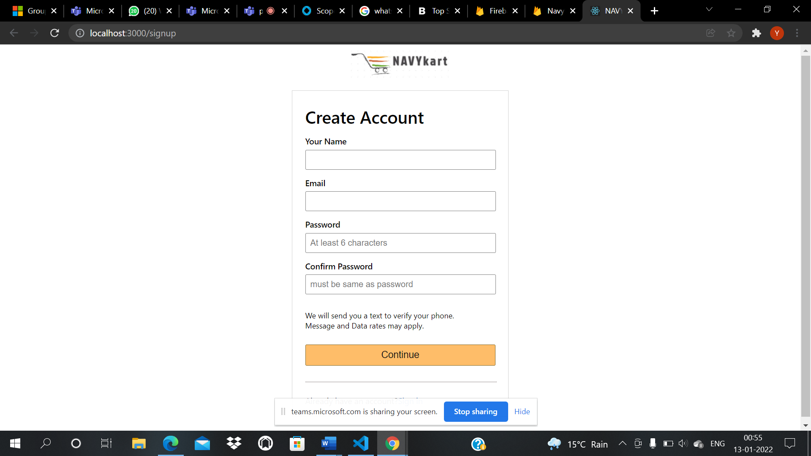
Registration form

Slide 7
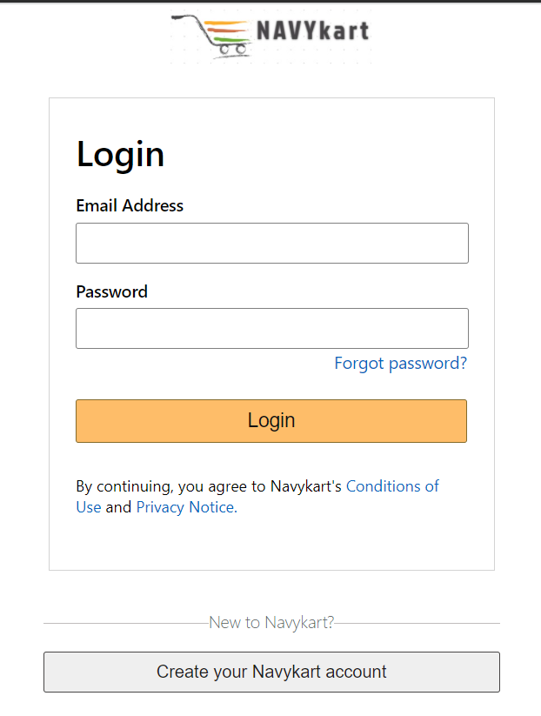
Login Page

Slide 8
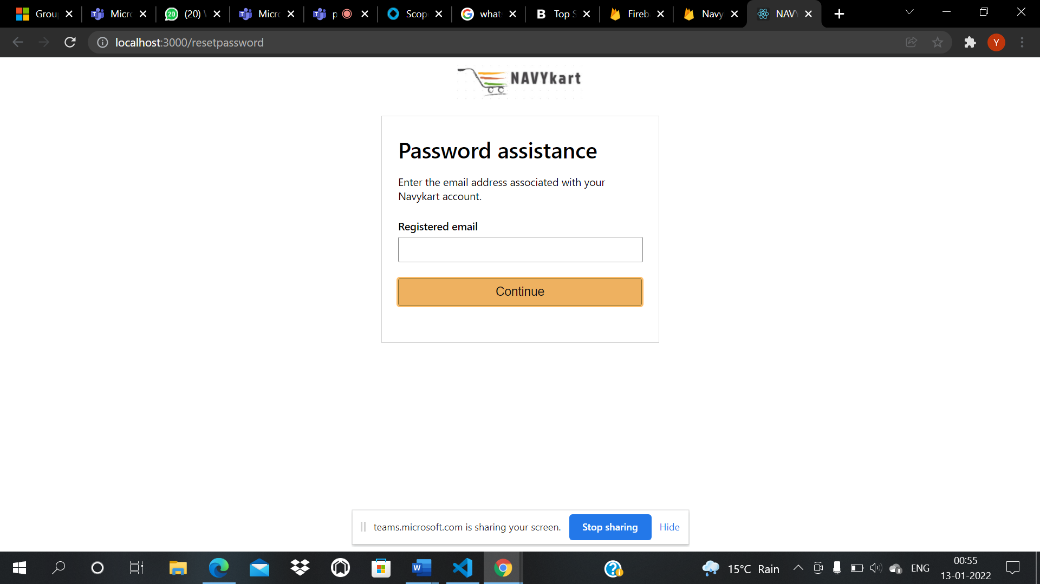
Reset Password

Slide 9
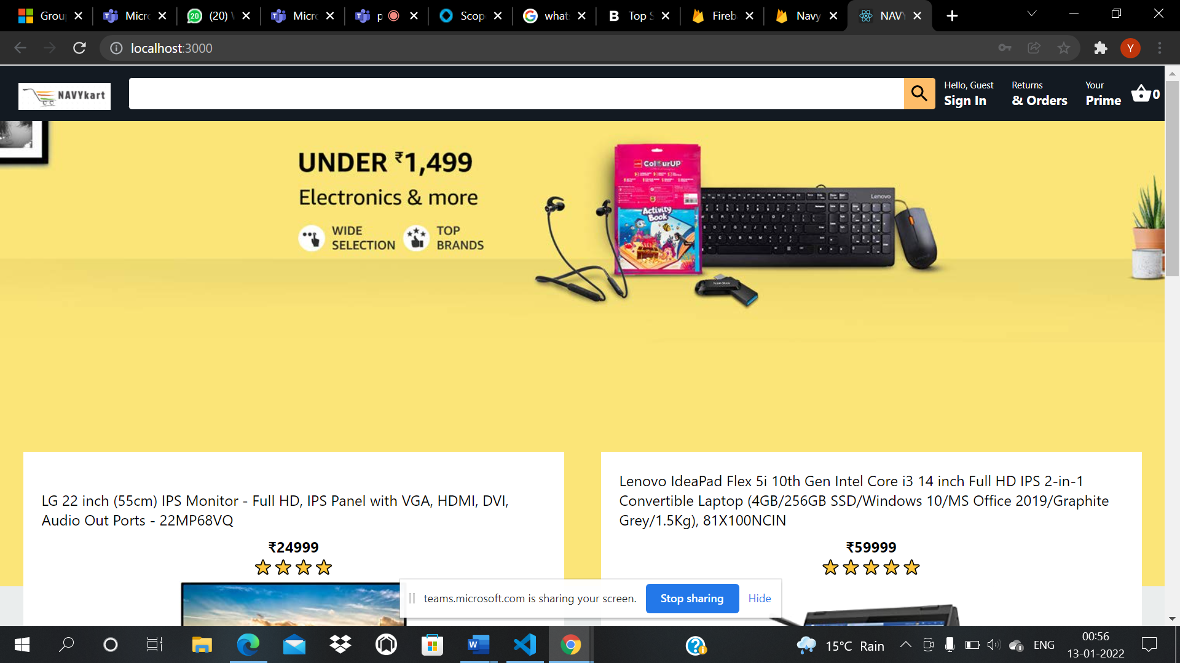
Home Page

Slide 10
Outcome
The results from this study showed that outcome value and process value contributed significantly to customer satisfaction and loyalty.
Shopping Enjoyment
Process Value
Time Saving

Slide 11
Conclusion
It is An User Friendly Application
With New technology comes better way of doing things.
Being able to buy anytime anywhere
Allows to place order before purchasing
Home Delivery
Widespread effect on economy and E-commerce

Slide 12


